Slide 1
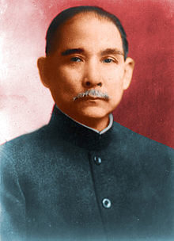
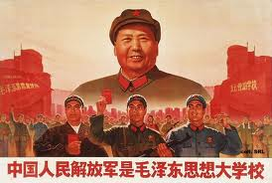
Chinese Revolution
Sun Yet-sun
Mao Zedong

Slide 2
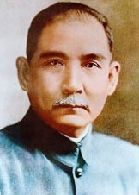
Nationalists Overthrow Qing Dynasty
  The Guomindang (Nationalist Party) pushed for modernization and nationalization.
  Their first great leader was Sun Yet-sen
  In 1911, the Revolutionary Alliance overthrew the last emperor of the Qing dynasty

Slide 3
Shaky Start for the New Republic
  1912, Sun Yet-sen became president of the Republic of China
  “Three Principles of the People”
    1. Nationalism—an end to foreign control
    2. People’s rights—democracy
    3. People’s livelihood—economic security for all Chinese

Slide 4
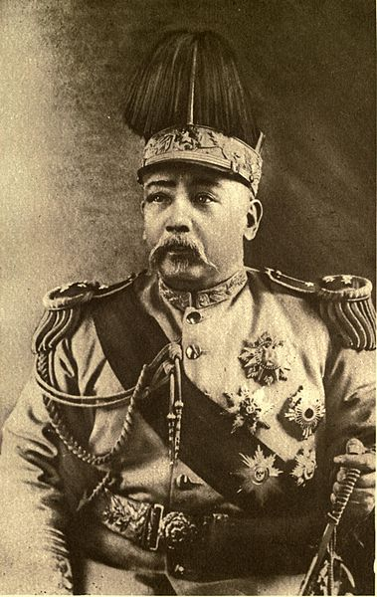
    General Yuan Shikai takes over presidency
      Shikai betrays democratic ideals
      Local revolts break out
      In 1916 civil war breaks out after Shikai’s death
      Provincial warlords held real authority—terrorized the countryside, looted
      Chinese peasants suffered, crops were destroyed

Slide 5
World War I Spells More Problems
    In 1917, the Beijing government declared war against Germany
      They believed the Allies would return Chinese territories controlled by Germany to China
      Allies gave Japan Chinese territories under Treaty of Versailles
    Treaty of Versailles outrages Chinese people
    3,000 angry students gather in Beijing May 4, 1919.
      May Fourth Movement—Workers, manufactures, shopkeepers, and professionals joined this caused and was supported by Mao Zedong

Slide 6
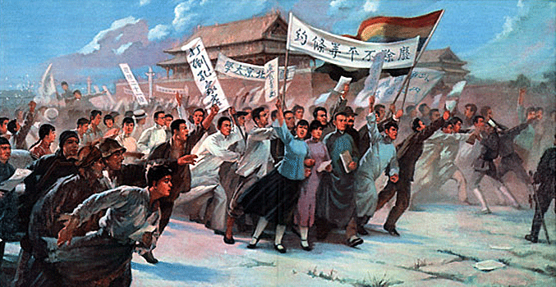
May Fourth Movement

Slide 7
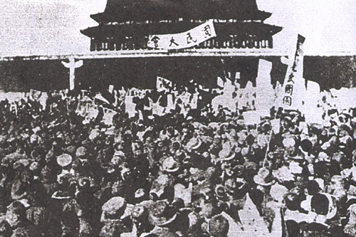
Protestors dissatisfied with the Treaty of Versailles for China

Slide 8
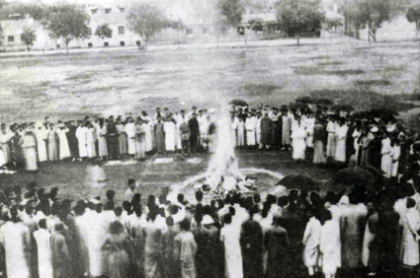
Tsinghua University students burn Japanese goods.

Slide 9
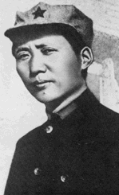
The Communist Party in China
  In 1921 a group in Shanghai (including Mao Zedong) organizes the Chinese Communist Party.
  Mao Zedong develops his own brand of communism and later became China’s greatest revolutionary leader
    Chinese intellectuals turned from Sun Yet-sen’s (democracy beliefs) in favor of Lenin’s brand of Soviet communism
    Mao brought the revolution to the rural country
Mao Zedong

Slide 10
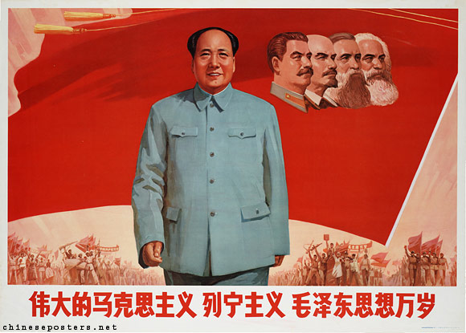
Lenin Befriends China
    Sun Yet-sen government is in south China
    The Guomindang ally with the Communist Party in attempts to unite all the revolutionary groups for common action
    Lenin seized opportunity and called for a worldwide revolution

Slide 11
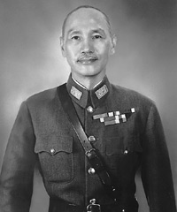
Peasants Align Themselves With The Communists
  Peasants Align with the Communists
    Sun Yixian died in 1925, and Chiang Kai-shek heads the Guomindang
    Kai-shek (son of a middle-class merchant) feared communist goal of forming a socialist government
    Kai-shek promised democracy, but his government became corrupt
As a result peasants threw their support toward the Chinese Communist Party

Slide 12
The Communist Party in China
  Nationalists and Communists Clash
    Briefly Kai-shek set aside differences and fought warlords alongside the Communists, but later turned against the Communists.
    April 1927 Nationalists groups moved on Shanghai and killed many Communists
    In 1928 Kai-shek became president of the Nationalist Republic of China
      Great Britain and the United States recognized his government.
      The Soviet Union did NOT recognize his government
      Civil War breaks out which lasts until 1949.

Slide 13
Civil War Rages in China
  In 1930 a bloody civil war was raging.
    Mao and Communists established themselves in south-central China.
      Taking his revolution to the countryside was called “swimming in the peasant sea.”
      Mao recruited peasants into the Red Army (Soviet Union) and trained them in guerilla warfare
      Nationalists attacked Communists but failed to drive them out

Slide 14
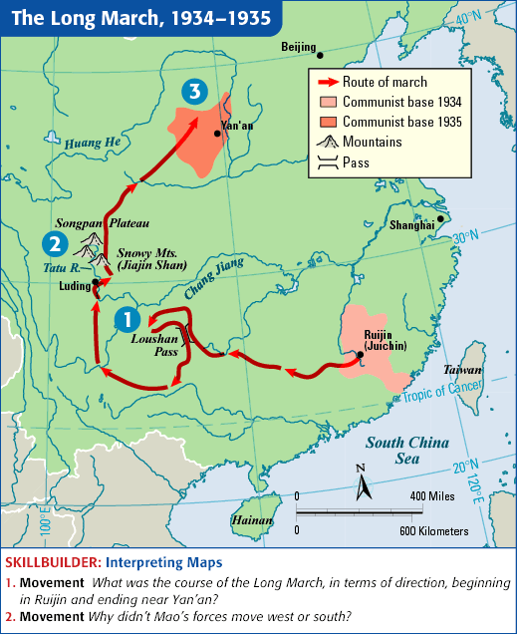
The Long March
    1933 Jiang gathered an army of 700,000 to surround the Communist stronghold
    In a daring move, 100,000 Communist forces fled 6,000 miles on the Long March to northern China between 1934 and 1935
    Mao and survivors settle in caves in northern China
    During this civil war, Japan invades China

Slide 16
Civil War Suspended
    Japan took advantage of China’s weakened situation during the civil war and invaded Manchuria, an industrial province in northeastern China
    In 1937, Japan launched an all-out invasion of China-- held large parts of China by 1938
    The Japanese threat forced an uneasy truce between the Jiang’s and Mao’s forces, and they united to fight the Japanese
    The National Assembly further agreed to promote changes outlined in Sun Yet-sen’s “Three Principles of the People”

